Slide 1
15-745
Inter-procedural analysis
Andrew Chung, Yue Niu

Slide 2
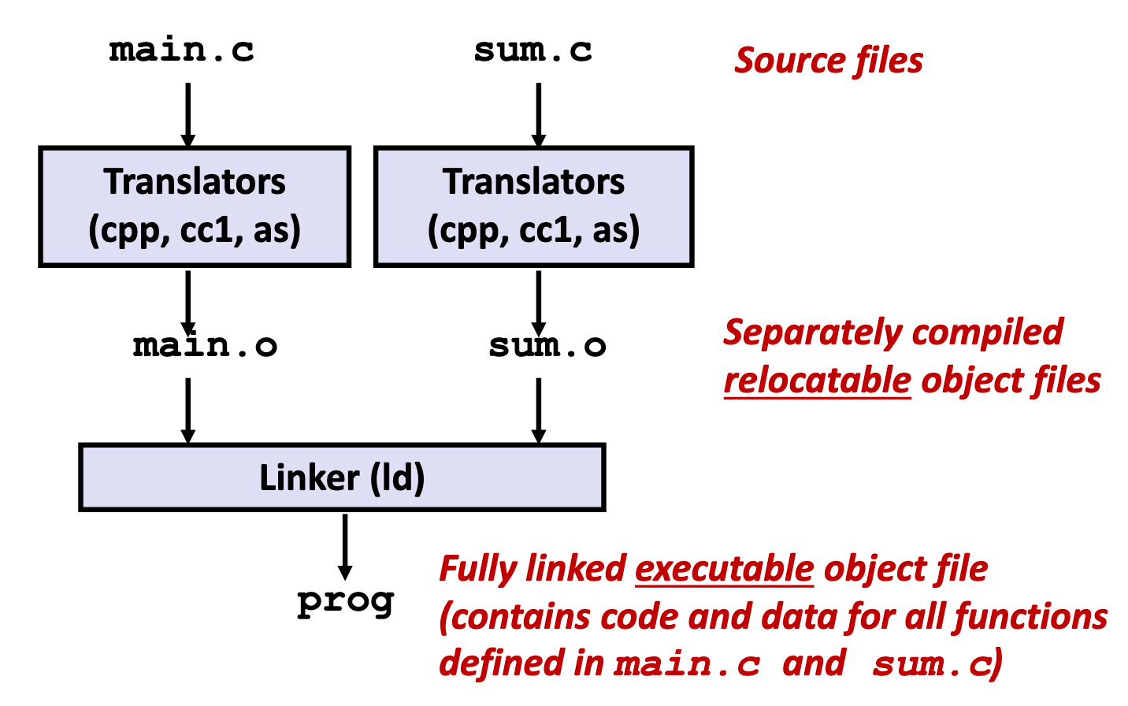
Introduction: Inter-procedural optimization
Compilers
Operate on single translation unit (module) (src + headers) to produce obj files
Optimizations usually applied within module
Linker combines obj files into resulting binary
Inter-procedural optimization (IPO)
Optimizations at/above the module scope
e.g., function inlining
Cross-module optimization (CMO)
Optimizations across modules
Link-time optimization (LTO): an approach that performs optimizations at link time
Whole program optimization (WPO)
An aspect of CMO, but can think of as same

Slide 3
ThinLTO: Scalable and Incremental LTO
Teresa Johnson, Mehdi Amini, Xinliang David Li

Slide 4
Paper introduction
Problem: LTO expensive
Bottleneck: Typically, CMO step is serial
Little parallelism, dep tracking, and non-linear algo → memory + build time intensive
Goals
Improve on compilation speed vs traditional LTO without compromising quality
No strict reliance on profile runs
Incremental build support
This paper...
Runs a thin link-time cross-module analysis phase using module summaries
Push IR transformation to parallel module optimization phase
Support incremental builds using hash(compiled IR + link-time analysis result)
Skip objects to compile + code-gen if no hash diff

Slide 5
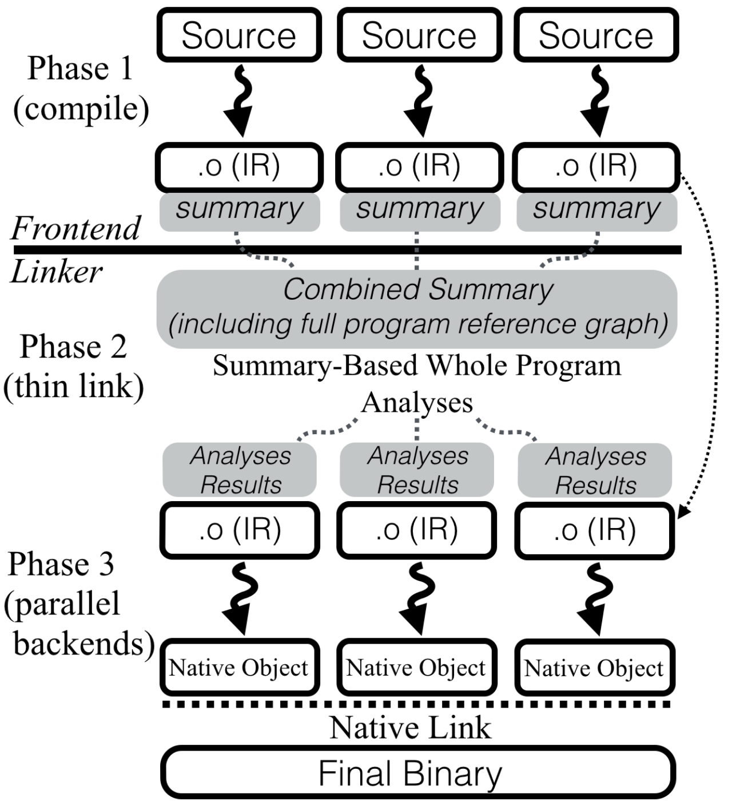
3-phase design
Phase 1: Compilation
Frontend translates source to IR (obj files)
Generate module summary for each obj
Contains func & global var metadata for P2
Phase 2: Thin link
Combine module summaries into summary idx to create call/reference graphs (CG)
Serial analysis with only module summaries
Operations on IR (loading + analysis + transformations that req. dep) is serial
Usually most costly → make bottleneck fast!
Phase 3: Backend compilation
Parallel IR transformation based on analysis
Dependent components ID’d and loaded

Slide 6
Implemented cross module optimizations (CMO)
Function importing: ID funcs to import into module for transformation
Application: Func inlining, which requires imported external functions for transformation
Serial analysis: Use heuristics + summary idx to see if inline-likely
Traverse CG and evaluate “profitability” based on func summary
Traverse down chains until not profitable
More lines/nested calls to reach ⇒ less likely to be inlined
Include function into module if profitable for parallel transformation
Profile-guided optimization optional
Transformation: Evaluate the inline decision, can be parallel since external module included
Internalization: Flag global symbols if only referenced by single module
Serial analysis: Perform flagging using reference graph
Transformation: “Internalize” flagged symbol references into the single module
...and others!

Slide 7
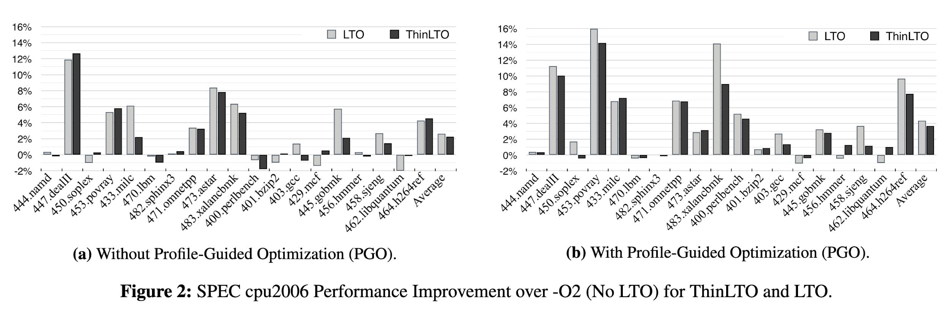
Evaluation: runtime performance
SPEC cpu2006, comparable/only a bit worse than GCC LTO, where 0% = no LTO

Slide 8
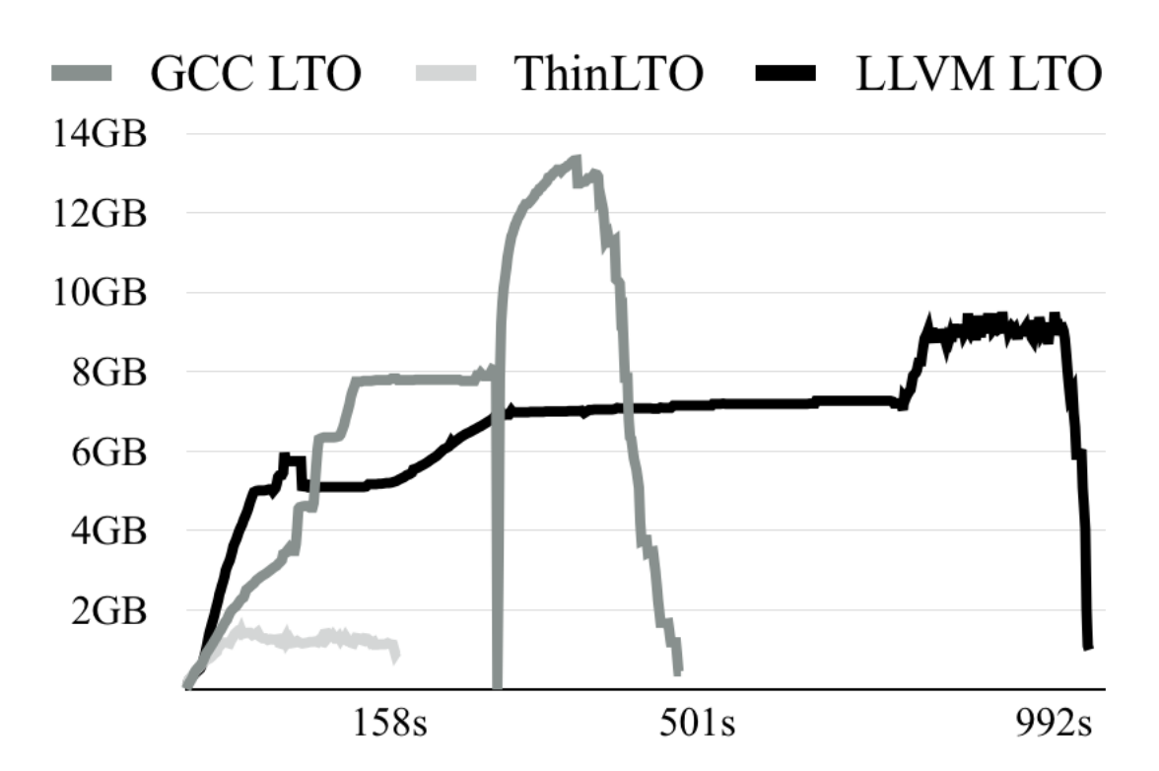
Evaluation: build performance
Compiling Chromium: significantly lower memory footprint + shorter time Other more fine-grained experiments and benchmarks available in paper

Slide 9
Incremental Whole Program Optimization and Compilation
Patrick W. Sathyanathan, Wenlei He, Ten H. Tzen

Slide 10
Introduction
Problem
Edit-compile-test cycle with WPA/O takes too long
Goals
No diff between incremental build vs full rebuild
Preserve debugging experience in incremental build
This paper
Proposes
An extensible incremental compilation framework
An incremental WPA algorithm that does not lose precision
Details data structures, techniques, and edge cases

Slide 11
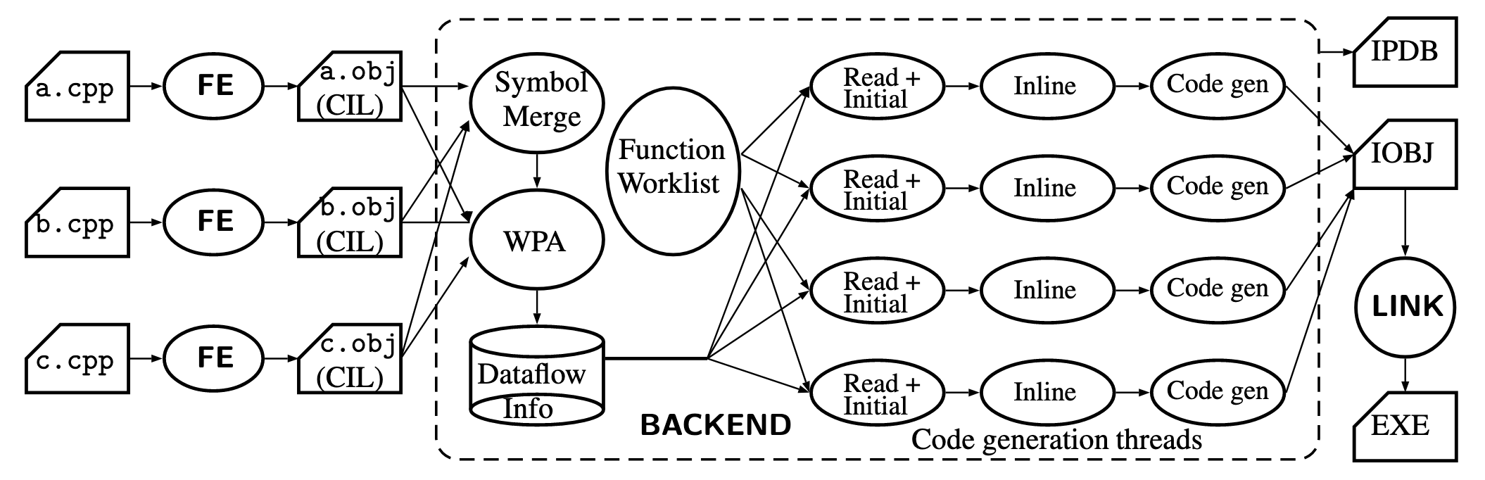
Framework
Components
CIL = IR in Visual C++ world
IPDB (incremental program database) stores dependencies & artifacts between compilation
LINK here refers to native linking

Slide 12
Incremental compilation algorithm
ID changed functions with checksum diff vs IPDB lookup
ID affected functions with incremental whole program analysis (later)
// Callers of affected funcs to re-eval inline decisions — inliner may decide differently
For each function in post-order
If affected: re-run all compilation phases
Otws: compile to post-inline (cheap because early), run cksm diff, and compile rest if changed
// IPDB doesn’t store inline decisions — expensive (n² CG edges w/ negative decisions)
If recompilation info changed vs IPDB lookup, add callers to affected functions
Compute unaffected funcs (= all - affected), then ID only reachable ones
// removes deleted code -- otws unaffected but deleted code put back in
Update debug info of unaffected funcs to reflect changes
// e.g., code-lines can change

Slide 13
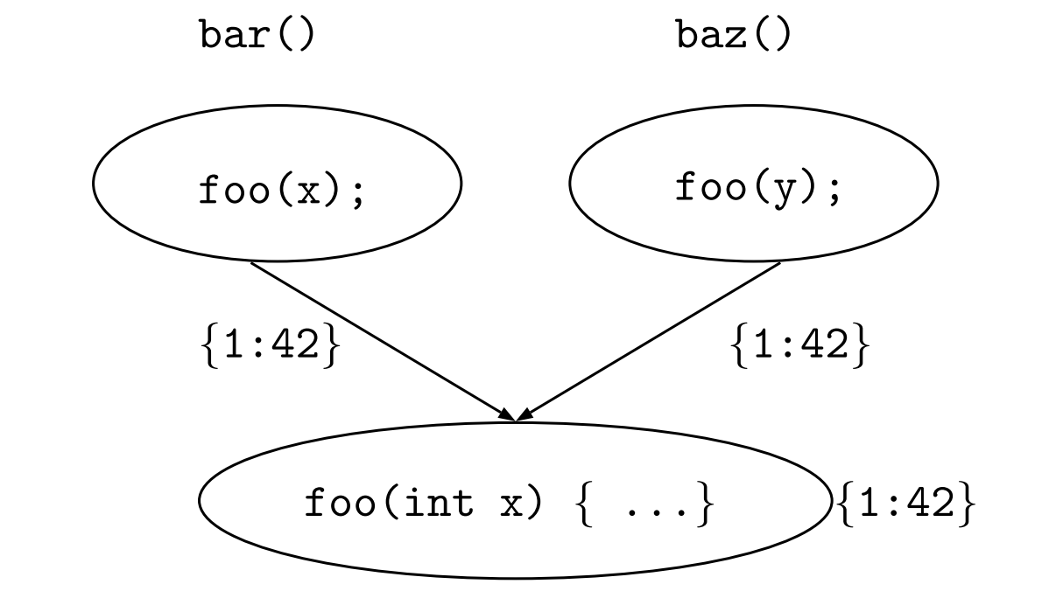
Incremental WPA
Only analyze the minimal set of functions affected by an edit
Start from the set of directly edited functions S
For each callee c of f in S, reanalyze callers of c
Recompute entry data value of c. If changed, add to c S

Slide 14
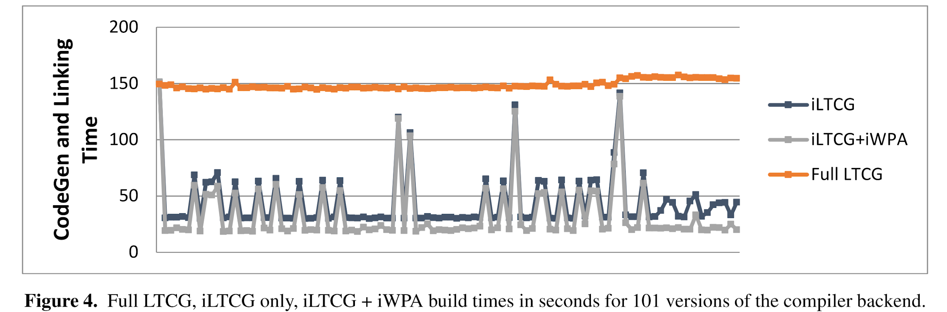
Experiments
VC/C++ codebase
1 mil LOC, 52K functions
More than 7X improvement in build times
Large spikes: forward integration from parent branch

Slide 15
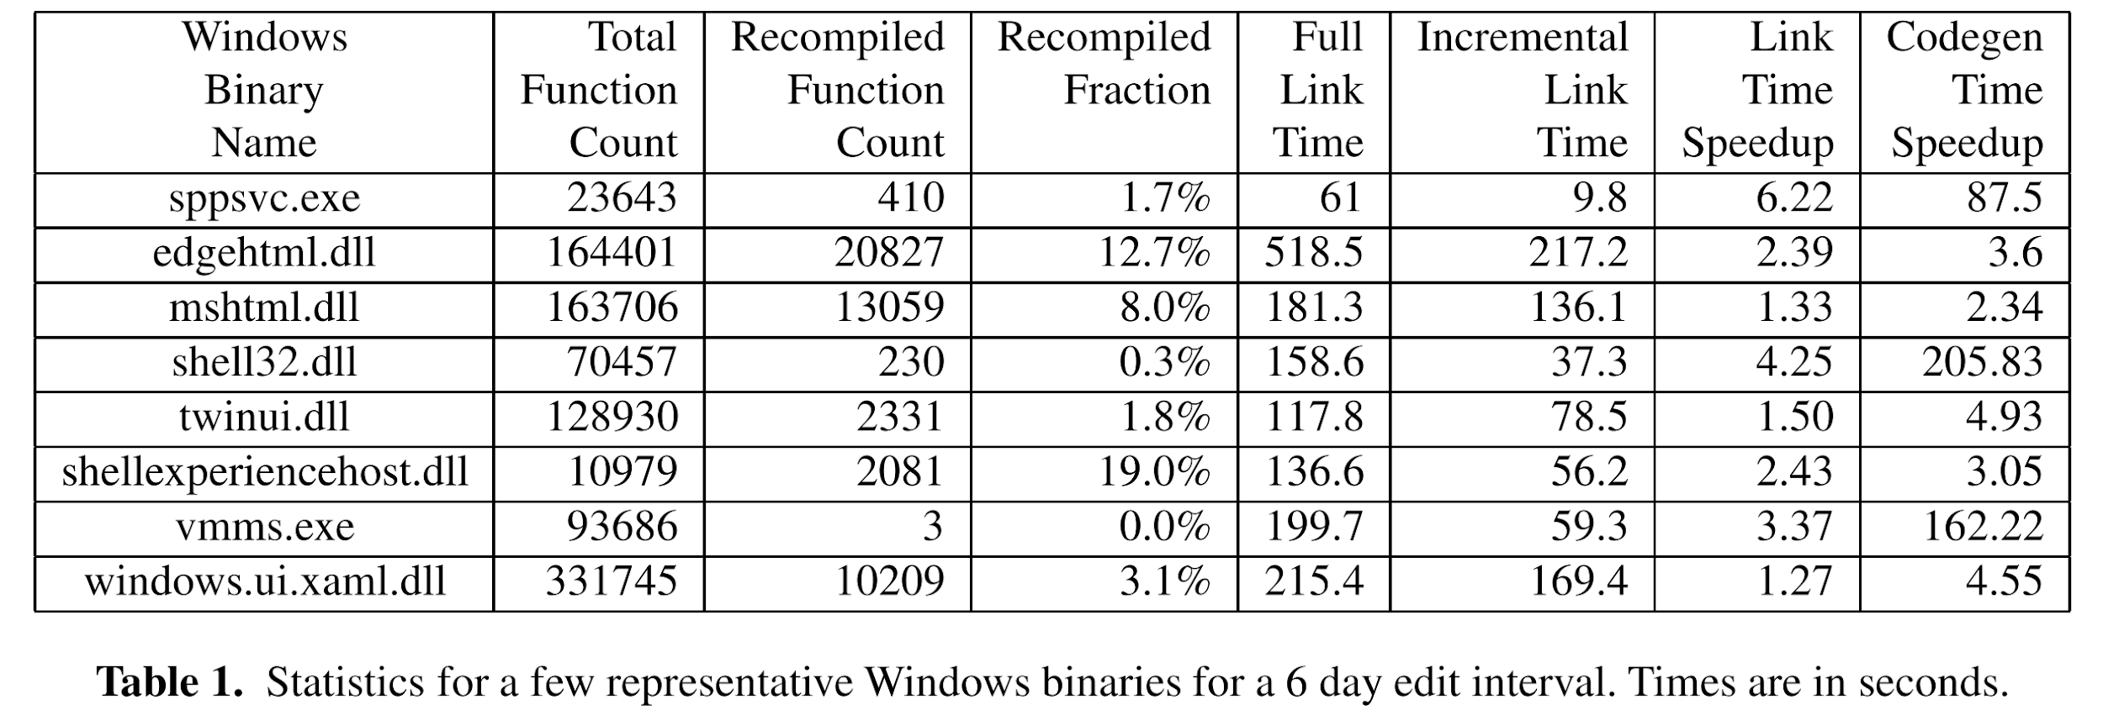
Experiments
Windows codebase, edits at 2 week intervals
Link time 3h => 2h20m (22% improvement)
16% functions recompiled
I/O bound: source files, CIL and COFF object files, and the IPDB contends for cache
Smaller windows binaries:

Slide 16
Inference of peak density of indirect branches to detect ROP attacks
Mateus Tymburiba, Rubens E. A. Moreira,
Fernando Magno Quintao Pereira

Slide 17
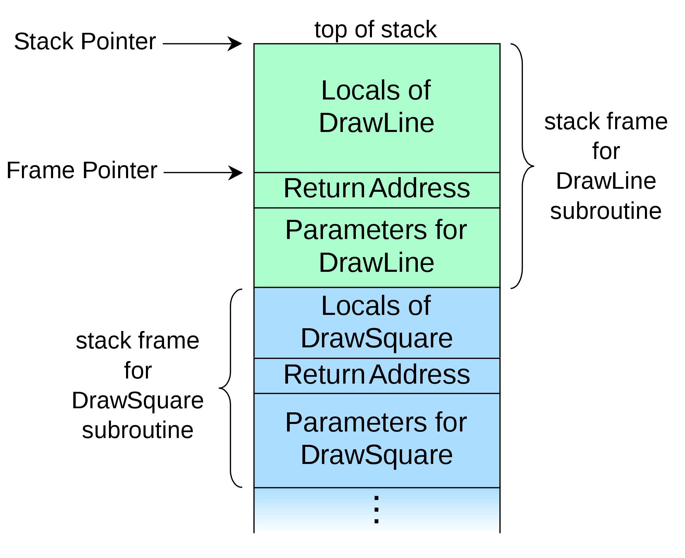
Return Oriented Programming (ROP)
Form of attack based on buffer overflow
Overwrites return address of function
Chains together gadgets
Turing complete

Slide 18
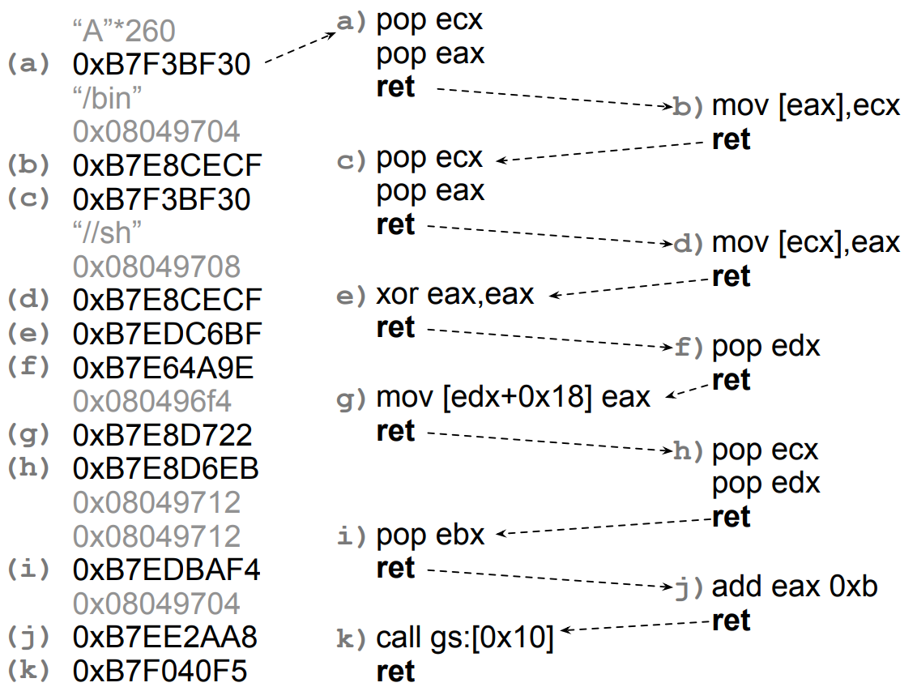

Slide 19
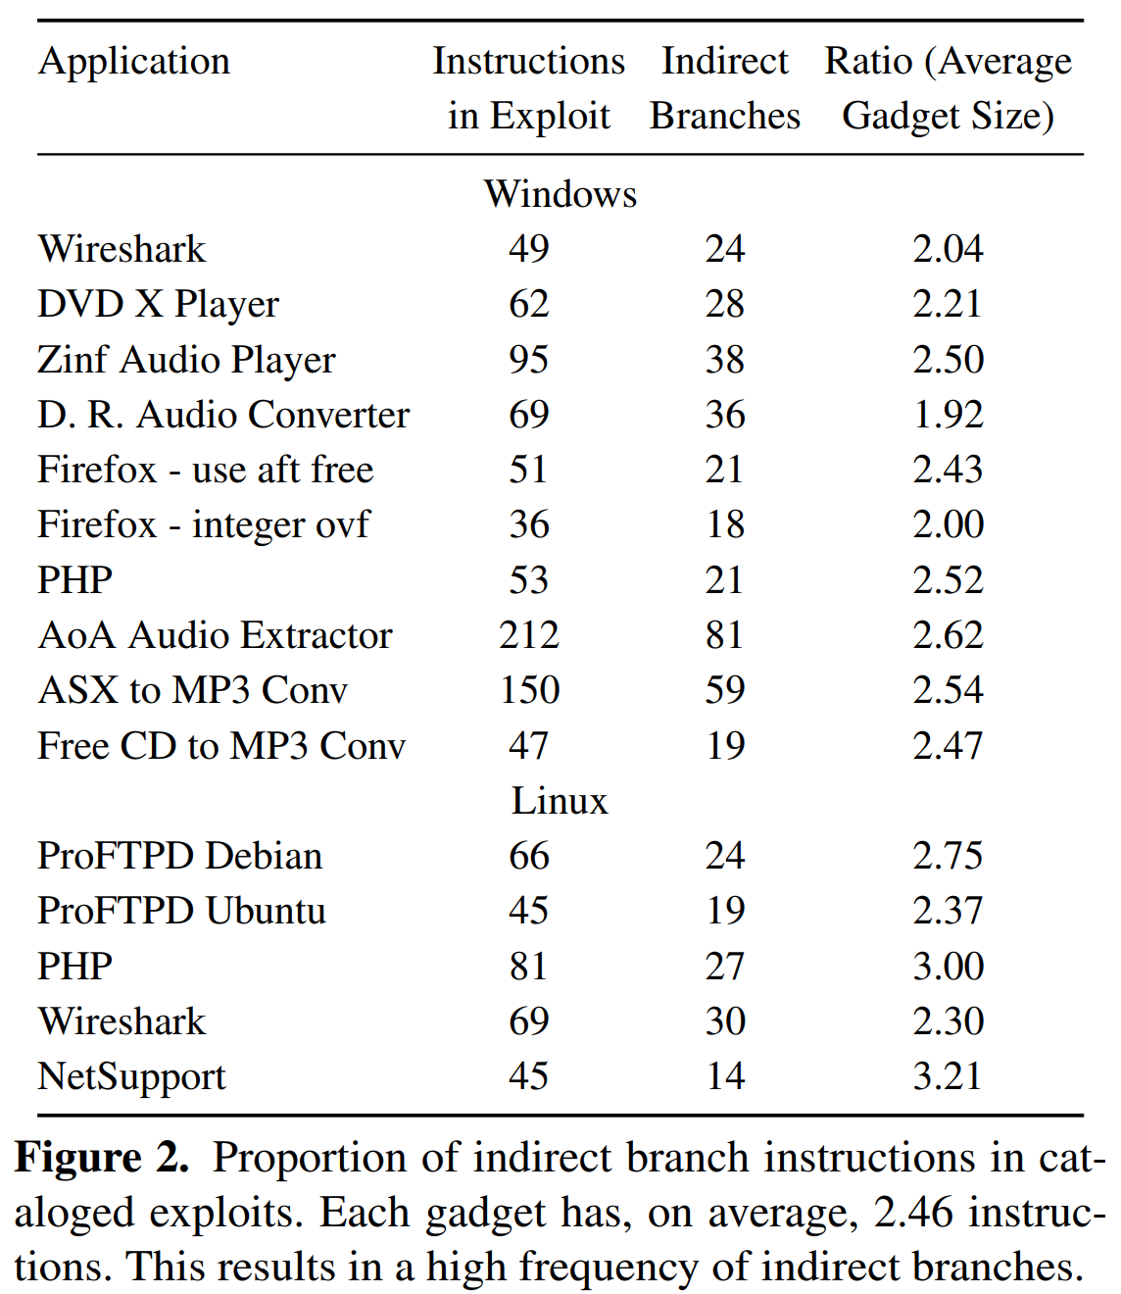
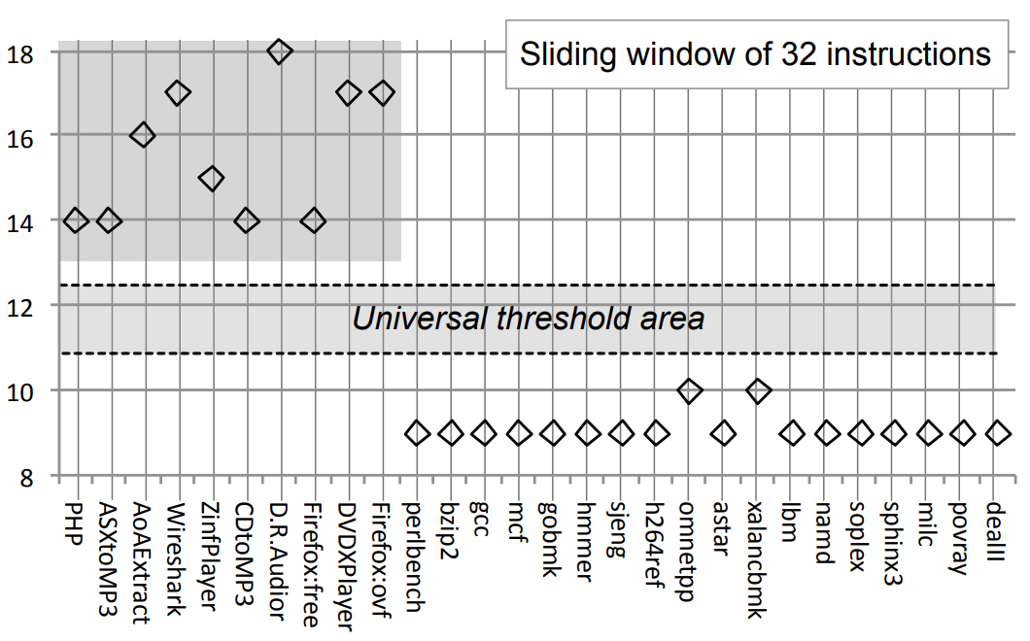

Slide 20
Universal Threshold
ROP require gadgets to be small
Idea: look at frequency of indirect branches via a sliding window
Exploit Database: 10-13 is universal threshold

Slide 21
Evading Universal Threshold
Possible to interpose no-op gadgets
Cannot change registers or stack
Static initializer
Alignment block

Slide 22
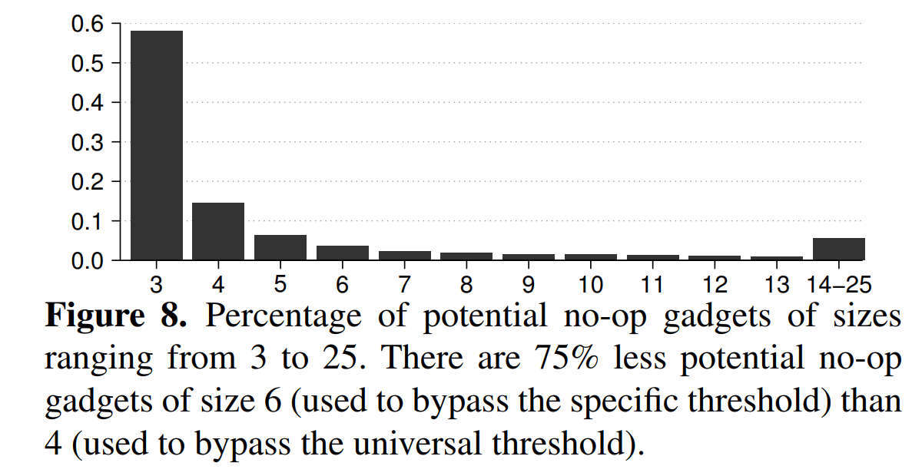
Specific Threshold
Compute indirect branch frequency for each application
More precise
Reduce space of available gadgets

Slide 23
Static Inference of Specific Thresholds
(IPD) Given a Program P, and integers K and R, is there an execution trace of P with no more than K instructions and R indirect branches?
δCFG: simplified CFG for IPD
Nodes are BBs recording only the number of instructions (n)
Node types:
BBL(n) : BBs that end in direct branches
RET(n, l) : BBs that end in returns, where l is the list of nodes this node can return to
FUN(n, e, r) : BBs that end in calls, where e is the first BB of the callee, and r is the node immediately after the caller

Slide 24
Algorithm
Instance (P,K)
For all nodes n in the δCFG:
Explore n with empty call stack and budget K
Explore n stack K:
n = RET(m,l)
If stack is empty: do explore l stack (K-m), return the maximum density
Else, stack = n::s. Do explore n s (K-m)
n = BBL(m,l,r)
Return max of {explore l stack (K-m), explore r stack (K-m)}
n = FUN(m,e,r)
Return explore e (r::stack) (K-m)

Slide 25
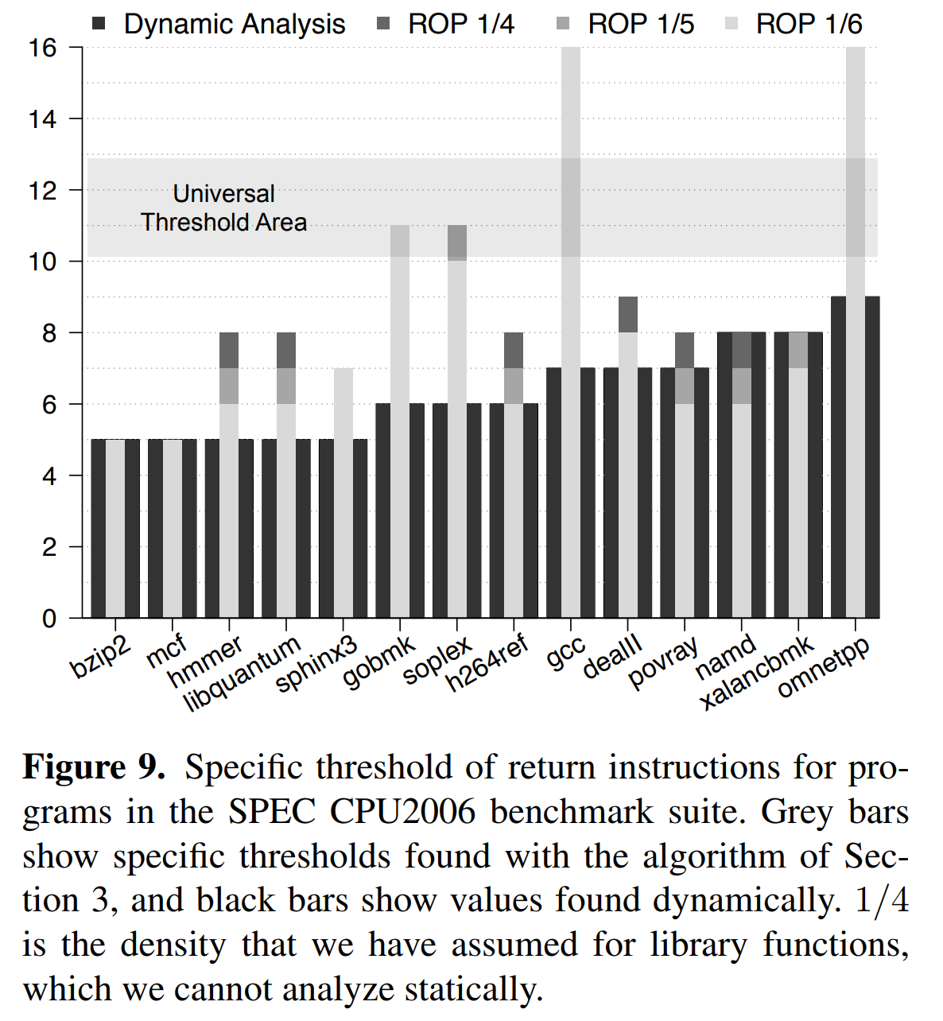
Experiments

